Slide 1

TARGET FOLDER
SRNTGT050
Murmansk Oil& Fuel Storage
OPAC CLASSIFIED
REL TO CJTF-23
OPAC CLASSIFIED
REL TO CJTF-23

Slide 2

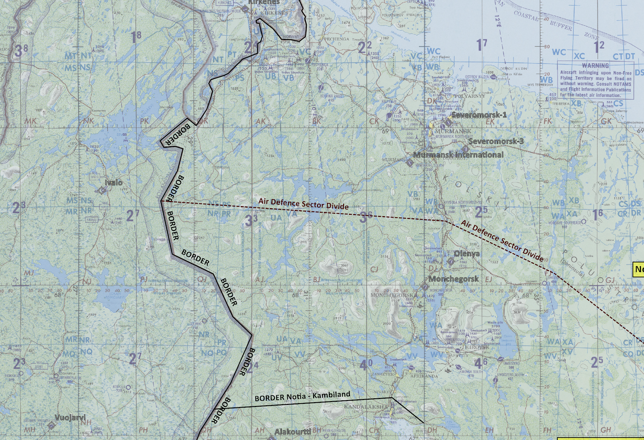


 | SRNTGT050 - Murmansk Oil& Fuel Storage JOINT OPERATIONS GRAPHIC | MAP OVERVIEW | OPAC CLASSIFIED REL TO CJTF-23
 | BE: SRNTGT050 CATCODE: 7 MIDB GEO: [N 68 55.972] [E033 03.240] ICOD: 2011-07-01 DOI: 2011-05-12 |  | DECL ON: 2061-01-01(+50 YEARS)
OPAC CLASSIFIED
N
N
SRNTGT050 - Murmansk Oil& Fuel Storage
.
Murmansk Oil and Fuel storage is an strategic reserve storage for Notian armed forces. The
terminal holds 30% of fuel and oil needed for Notian armed forces. Destruction of the facility
will limit Notian armed forces access to necessary fuel and oil for movement of forces. How
large impact depends on status of other fuel and oil storages.
OPAC CLASSIFIED
REL TO CJTF-23

Slide 3

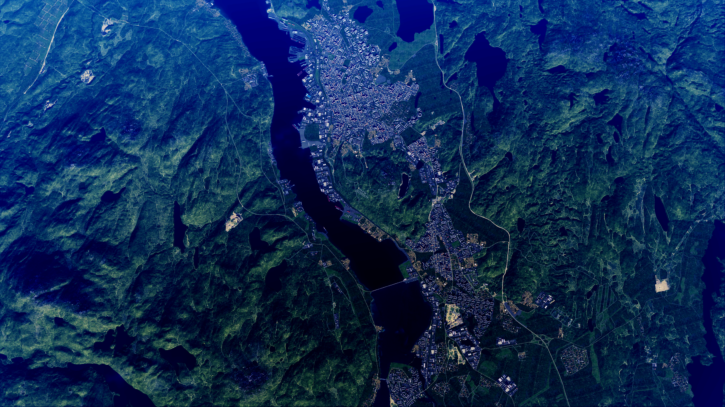
 | [SRNTGT050 - Murmansk Oil& Fuel Storage, SRN] COLLOCATED FACILITY GRAPHIC [SRNTGT-049] | MAP OVERVIEW | OPAC CLASSIFIED REL TO CJTF-23
 | BE: SRNTGT050 CATCODE: 7 MIDB GEO: [N 68 55.972] [E033 03.240] ICOD: 2011-07-01 DOI: 2011-05-12 |  | DECL ON: [YYYYMMDD] (+50 YEARS)
[CLASSIFICATION]
N
Murmansk
SRNTGT049 Murmansk Oil&Fuel Terminal
SRNTGT050- Murmansk Oil& Fuel Storage
TARGET
[CLASSIFICATION]
[DISSEMINATION CONTROLS]
TARGET OUTLINE
COLLOCATED FACILITY OUTLINE

Slide 4
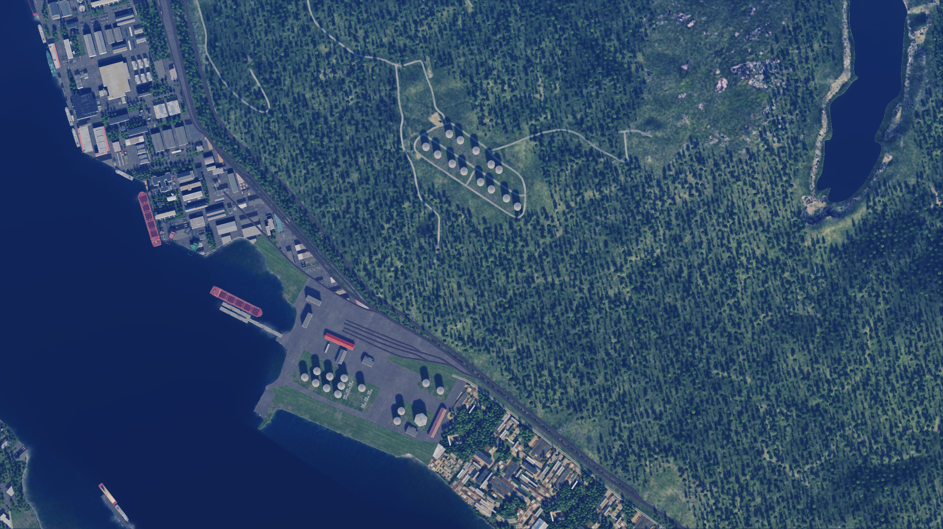
 | SRNTGT050 - Murmansk Oil& Fuel Storage FACILITY OUTLINE GRAPHIC | MAP OVERVIEW | OPAC CLASSIFIED REL TO CJTF-23
 | BE: SRNTGT050 CATCODE: 7 MIDB GEO: [N 68 55.972] [E033 03.240] ICOD: 2011-07-01 DOI: 2011-05-12 |  | DECL ON: 2061-01-01(+50 YEARS)
OPAC CLASSIFIED
N
N
SRNTGT050- Murmansk Oil& Fuel Storage
TARGET
OPAC CLASSIFIED
REL TO CJTF-23

Slide 5
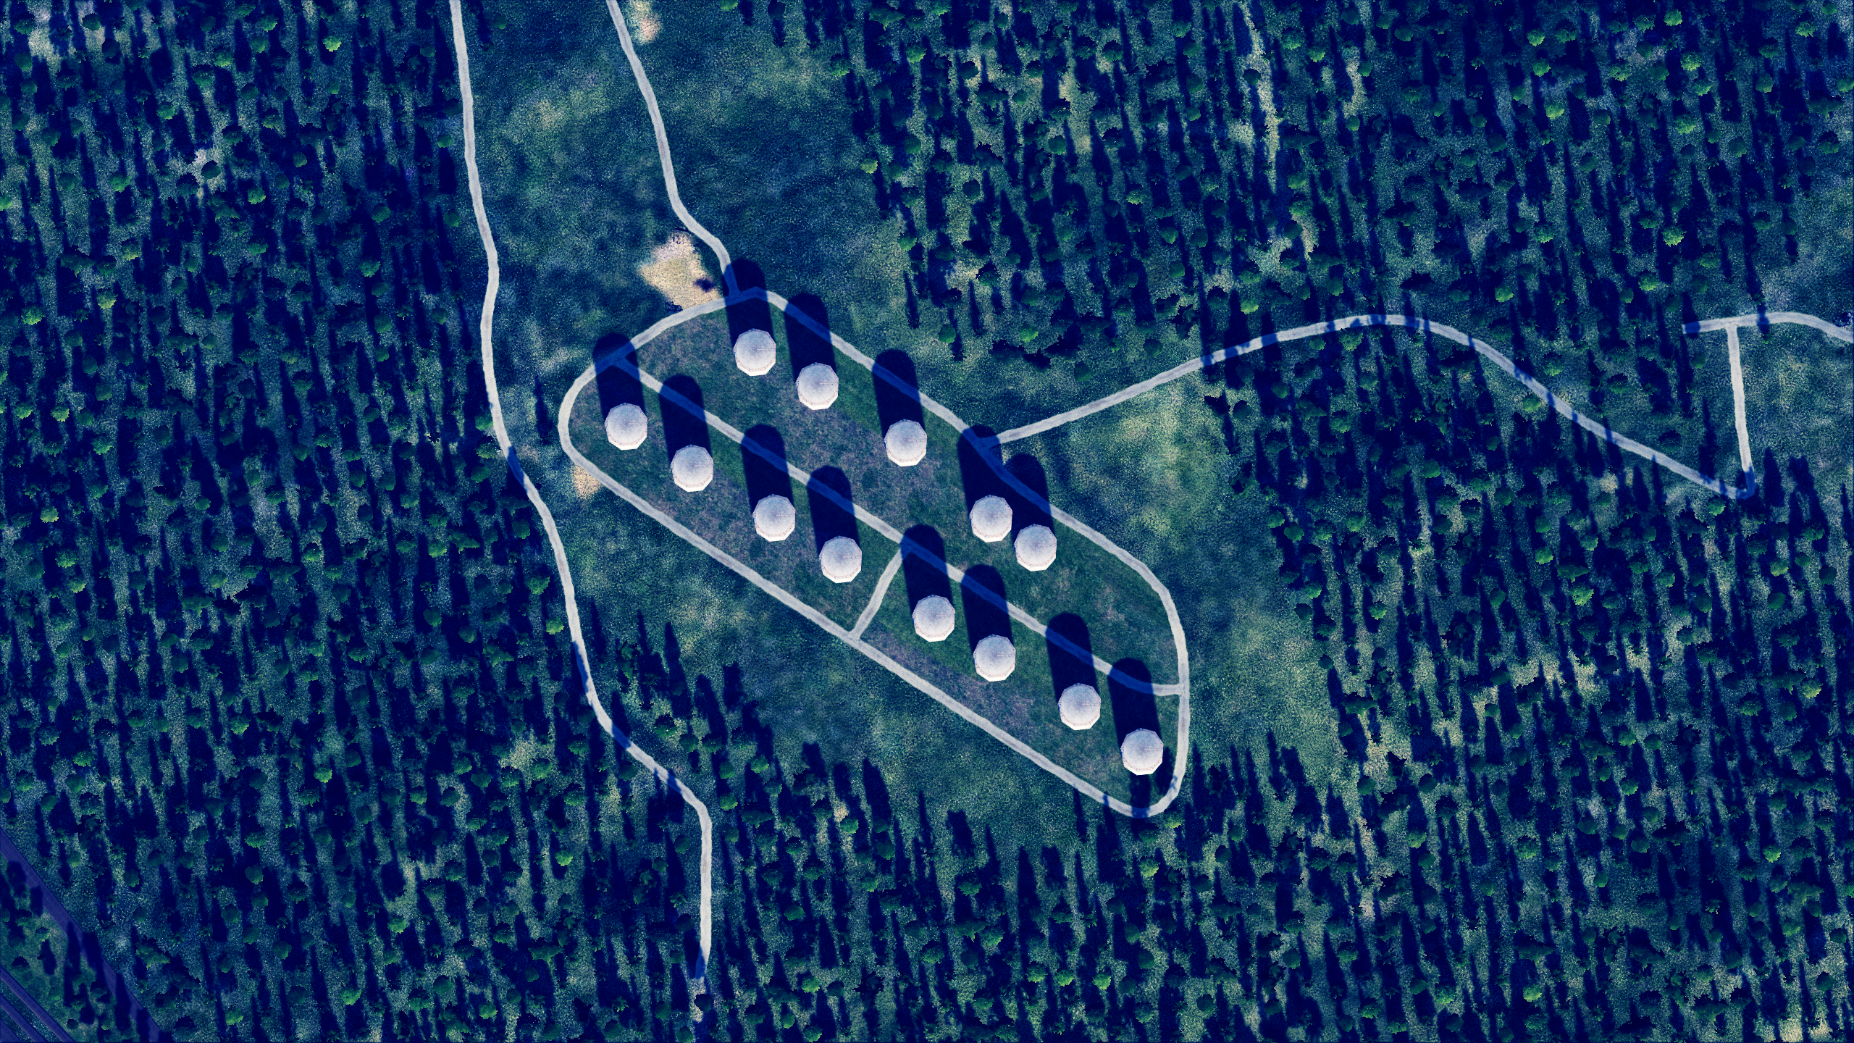
 | SRNTGT050 - Murmansk Oil& Fuel Storage JOINT DESIRED POINT OF IMPACT GRAPHIC [X] | MAP OVERVIEW | OPAC CLASSIFIED REL TO CJTF-23
 | BE: SRNTGT050 CATCODE: 7 MIDB GEO: [N 68 55.972] [E033 03.240] ICOD: 2011-07-01 DOI: 2011-05-12 |  | DECL ON: 2061-01-01(+50 YEARS)
OPAC CLASSIFIED
DPI: SRNTGT050A
OIL STORAGE
N 68 55.942 E 033 286
DPI MSL: 382 FT
N
N
DPI: SRNTGT050B
OIL STORAGE
N 68 55.922 E 033 03.318
DPI MSL: 379 FT
N
DPI: SRNTGT050C
OIL STORAGE
N 68 55.897 E 033 03.366
DPI MSL: 376 FT
DPI I
DPI J
DPI: SRNTGT050D
OIL STORAGE
N 68 55.875 E 033 03.396
DPI MSL: 376 FT
DPI K
DPI L
DPI: SRNTGT050E
OIL STORAGE
N 68 55.972 E 033 03.238
DPI MSL: 385 FT
DPI M
DPI: SRNTGT050F
OIL STORAGE
N 68 55.994 E 033 03.202
DPI MSL: 386 FT
DPI H
DPI: SRNTGT050G
OIL STORAGE
N 68 56.020 E 033 03.158
DPI MSL: 383 FT
DPI G
DPI F
DPI: SRNTGT050H
OIL STORAGE
N 68 56.042 E 033 03.122
DPI MSL: 384 FT
DPI E
DPI A
DPI: SRNTGT050I
OIL STORAGE
N 68 56.044 E 033 03.252
DPI MSL: 409 FT
DPI B
DPI C
DPI D
DPI: SRNTGT050J
OIL STORAGE
N 68 56.025 E 033 03.289
DPI MSL: 409 FT
DPI: SRNTGT050K
OIL STORAGE
N 68 55.996 E 033 03.335
DPI MSL: 404 FT
DPI: SRNTGT050L
OIL STORAGE
N 68 55.963 E 033 03.371
DPI MSL: 406 FT
DPI: SRNTGT050M
OIL STORAGE
N 68 55.948 E 033 03.395
DPI MSL: 405 FT
OPAC CLASSIFIED
REL TO CJTF-23

Slide 6
 | SRNTGT050 - Murmansk Oil& Fuel Storage WEAPONEERING OPTIONS | MAP OVERVIEW | OPAC CLASSIFIED REL TO CJTF-23
 | BE: SRNTGT050 CATCODE: 7 MIDB GEO: [N 68 55.972] [E033 03.240] ICOD: 2011-07-01 DOI: 2011-05-12 |  | DECL ON: 2061-01-01(+50 YEARS)
OPAC CLASSIFIED
DPI | DESCRIPTION | TLE | WARHEAD | GUIDANCE | DESIRED EFFECT | IMPACT ANGLE | FUZING
A | OIL STORAGE | CAT2 | 1000 | DECIMETRIC | BLAST, FRAGMENTATION | 45-90 | 25ms
B | OIL STORAGE | CAT2 | 1000 | DECIMETRIC | BLAST, FRAGMENTATION | 45-90 | 25ms
C | OIL STORAGE | CAT2 | 1000 | DECIMETRIC | BLAST, FRAGMENTATION | 45-90 | 25ms
D | OIL STORAGE | CAT2 | 1000 | DECIMETRIC | BLAST, FRAGMENTATION | 45-90 | 25ms
E | OIL STORAGE | CAT2 | 1000 | DECIMETRIC | BLAST, FRAGMENTATION | 45-90 | 25ms
F | OIL STORAGE | CAT2 | 1000 | DECIMETRIC | BLAST, FRAGMENTATION | 45-90 | 25ms
G | OIL STORAGE | CAT2 | 1000 | DECIMETRIC | BLAST, FRAGMENTATION | 45-90 | 25ms
H | OIL STORAGE | CAT2 | 1000 | DECIMETRIC | BLAST, FRAGMENTATION | 45-90 | 25ms
I | OIL STORAGE | CAT2 | 1000 | DECIMETRIC | BLAST, FRAGMENTATION | 45-90 | 25ms
J | OIL STORAGE | CAT2 | 1000 | DECIMETRIC | BLAST, FRAGMENTATION | 45-90 | 25ms
K | OIL STORAGE | CAT2 | 1000 | DECIMETRIC | BLAST, FRAGMENTATION | 45-90 | 25ms
L | OIL STORAGE | CAT2 | 1000 | DECIMETRIC | BLAST, FRAGMENTATION | 45-90 | 25ms
M | OIL STORAGE | CAT2 | 1000 | DECIMETRIC | BLAST, FRAGMENTATION | 45-90 | 25ms
OPAC CLASSIFIED
REL TO CJTF-23
Notes:
TLE 1: 0-6m
TLE 2:7-15m
TLE 3:16-30m
TLE 4:31-91m
TLE 5:92-305
TLE 6: >305m
Warhead: 500Ibs, 1000Ibs, 2000Ibs
Guidance: N/A, Laserguided, INS/GPS

Slide 7
 | SRNTGT050 - Murmansk Oil& Fuel Storage COLLATERAL DAMAGE ESTIMATION GRAPHIC [X] | MAP OVERVIEW | OPAC CLASSIFIED REL TO CJTF-23
 | BE: SRNTGT050 CATCODE: 7 MIDB GEO: [N 68 55.972] [E033 03.240] ICOD: 2011-07-01 DOI: 2011-05-12 |  | DECL ON: 2061-01-01(+50 YEARS)
OPAC CLASSIFIED
NO COLLATERAL ISSUES
ALL WARHEADS ARE MINIMUMS, CAN BE LARGER PER AVAIL.
N
CER XXXM / XXXft
N
METER | FEET
50 | 165
75 | 246
100 | 328
150 | 492
200 | 656
250 | 820
300 | 984
DPI X
NCC: [NAME] [TYPE]
XX FT SW FROM DPI X
OPAC CLASSIFIED
REL TO CJTF-23
[CDE]
Notes:
CDE 1: No restriction
CDE 2: Unitary warhead only (no cluster munition), and FAH restrictions to minimize collateral damage
CDE 3: PGM, unitary
CDE 4: Weaponeering (Fuze setting, FAH, smallest possible bomb)
CDE 5: CJTF-HQ approval needed

Slide 8
 | SRNTGT050 - Murmansk Oil& Fuel Storage BATTLE DAMAGE ASSESSMENT GRAPHIC | MAP OVERVIEW | OPAC CLASSIFIED REL TO CJTF-23
 | BE: SRNTGT050 CATCODE: 7 MIDB GEO: [N 68 55.972] [E033 03.240] ICOD: 2011-XX-XX DOI: 2011-XX-XX (Or reference ATO Day) |  | DECL ON: 2061-01-01(+50 YEARS)
OPAC CLASSIFIED
POST-STRIKE
PRE-STRIKE
N
N
TARGET OBJECTIVE
DAMAGE/CHANGE ASSESSMENT
DPI:[SRNTGT050]
OPAC CLASSIFIED
REL TO CJTF-23
BDA REMARK: [CLASSIFICATION] [DISSEMINATION] Assessment: Physical Damage/change, Collateral Damage, Functional Damage/change, Munitions Effectiveness, Reattack Recommendation, Additional/Collateral Effects

Slide 9
 | SRNTGT050 - Murmansk Oil& Fuel Storage, SRN COLLATERAL DAMAGES ESTIMATION | MAP OVERVIEW | OPAC CLASSIFIED REL TO CJTF-23
 | BE: SRNTGT050 CATCODE: 7 MIDB GEO: [N 68 55.972] [E033 03.240] ICOD: 2011-07-01 DOI: 2011-05-12 |  | DECL ON: 2061-01-01(+50 YEARS)
OPAC CLASSIFIED
COLLATERAL DAMAGES WITHIN A 500M RADIUS
DESCRIPTION |  | CATCODE | MIDB GEOS | LOCATION | REMARKS
 |  | N/A | N/A
NO STRIKE ENTITIES WITHIN A 500M RADIUS
NSE ID | DESCRIPTION | CATCODE | MIDB GEOS | LOCATION | REMARKS
 |  | N/A | N/A
OPAC CLASSIFIED
REL TO CJTF-23
Notes:
Location Example: 247˚/ 680ft from DPI D

Slide 10
BAKCUP SLIDES AFTER THIS

Slide 11
 | [INSTALLATION NAME, SRN] INSTALLATION OUTLINE GRAPHIC [X] | MAP OVERVIEW | [CLASSIFICATION] [DISSEMINATION CONTROLS]
 | BE: [XXXXXXX] CATCODE: 7X MIDB GEO: [DDMM.MMM (N/S)] [DDDMM.MMM(E/W)] ICOD: [DDMMMYYYY] DOI:[DDMMMYYYY] |  | DECL ON: [YYYYMMDD] (+50 YEARS)
[CLASSIFICATION]
N
[CLASSIFICATION]
[DISSEMINATION CONTROLS]

Slide 12
 | [SRNTGT050 - Murmansk Oil& Fuel Storage, SRN] COLLOCATED FACILITY GRAPHIC [X] | MAP OVERVIEW | [CLASSIFICATION] [DISSEMINATION CONTROLS]
 | BE: [XXXXXXX] CATCODE: 7X MIDB GEO: [DDMM.MMM (N/S)] [DDDMM.MMM(E/W)] ICOD: [DDMMMYYYY] DOI:[DDMMMYYYY] |  | DECL ON: [YYYYMMDD] (+50 YEARS)
[CLASSIFICATION]
N
SRNTGT050 - Murmansk Oil& Fuel Storage
XXXXCDXXXX/CDX01
[CLASSIFICATION]
[DISSEMINATION CONTROLS]

Slide 13
 | [SRNTGT050 - Murmansk Oil& Fuel Storage, SRN] CRITICAL ELEMENT GRAPHIC [X] | MAP OVERVIEW | [CLASSIFICATION] [DISSEMINATION CONTROLS]
 | BE: [XXXXXXX] CATCODE: 7X MIDB GEO: [DDMM.MMM (N/S)] [DDDMM.MMM(E/W)] ICOD: [DDMMMYYYY] DOI:[DDMMMYYYY] |  | DECL ON: [YYYYMMDD] (+50 YEARS)
[CLASSIFICATION]
N
CE1
SUPPORT BLDG 01
PV CHAR: xxx xx
L = xxx FT, W = xx FT, H = xx FT
CE2
SUPPORT BLDG 02
PV CHAR: xxx xx
L = xxx FT, W = xx FT, H = xx FT
[CLASSIFICATION]
[DISSEMINATION CONTROLS]

Slide 14
 | [SRNTGT050 - Murmansk Oil& Fuel Storage, SRN] CRITICAL ELEMENT GRAPHIC [X] SPLIT REFERENCE OVERVIEW | MAP OVERVIEW | [CLASSIFICATION] [DISSEMINATION CONTROLS]
 | BE: [XXXXXXX] CATCODE: 7X MIDB GEO: [DDMM.MMM (N/S)] [DDDMM.MMM(E/W)] ICOD: [DDMMMYYYY] DOI:[DDMMMYYYY] |  | DECL ON: [YYYYMMDD] (+50 YEARS)
[CLASSIFICATION]
N
SPLIT 1 OF 2
SPLIT 2 OF 2
[CLASSIFICATION]
[DISSEMINATION CONTROLS]

Slide 15
 | [SRNTGT050 - Murmansk Oil& Fuel Storage, SRN] CRITICAL ELEMENT GRAPHIC SPLIT [X] OF [X] | MAP OVERVIEW | [CLASSIFICATION] [DISSEMINATION CONTROLS]
 | BE: [XXXXXXX] CATCODE: 7X MIDB GEO: [DDMM.MMM (N/S)] [DDDMM.MMM(E/W)] ICOD: [DDMMMYYYY] DOI:[DDMMMYYYY] |  | DECL ON: [YYYYMMDD] (+50 YEARS)
[CLASSIFICATION]
N
CE1
SUPPORT BLDG 01
PV CHAR: xxx xx
L = xxx FT, W = xx FT, H = xx FT
[CLASSIFICATION]
[DISSEMINATION CONTROLS]

Slide 16
ACRONYMS
ACRONYM | MEANING | DEFINITION
BE | Basic Encyclopedia Number | Alpha/numeric code unique to an installation for incorporation within various national and tactical systems.
CATCODE | Category Code | The data Element that classifies the function and purpose of an installation or a facility.
MIDB | Modernized Integrated Database | A database comprised of information on facilities of military significance, military forces, and related equipment.
ICOD | Intelligence Cut Off Date | The date of the latest intelligence data inputted to a feature.
DOI | Date of Image | Date on which a geospatial or intelligence-related image was captured.
CE | Critical Element | An element of an entity or object that enables it to perform its primary function.
PV CHAR | Physical Vulnerability Characteristic | Standardized alphanumeric code describing the physical and structural properties of a target.
JDPI | Joint Desired Point of Impact | A unique, alphanumeric coded aimpoint identified by a three dimensional mensurated point. It represents a weapon or capability desired point of impact or penetration.
CE90 | Circular Error at 90% | 90 percent confidence level in the horizontal plane.
LE90 | Linear Error at 90% | 90 percent confidence level in the vertical dimension
MSL | Mean Sea Level | Elevation above Earth reference geoid.
AGL | Above Ground Level | Elevation above ground surface.
NCC | Nearest Collateral Concern | Closest non-targeted structure, area, or entity near a planned point of impact that may be at risk of unintended damage during a military strike.
CER | Collateral effects radius | Radius within which collateral damage might happen based on the weapon's characteristics, the target environment, and other operational factors.
CDE | Collateral damage estimate | Systematic process used in military targeting to evaluate the potential for unintended damage or harm to non-combatant entities, structures, or personnel as a result of a planned strike.
NSE | No Strike Element | Specific entities, locations, or objects that are protected from intentional targeting under the Law of Armed Conflict (LOAC) or by operational policy.

Slide 17
TARGET CATEGORIES
TARGET CATEGORIES
CATEGORIES | TYPE
1 | Weapons of Mass destruction (Nuclear, Biological, Chemical)
2 | Command, Control and Communications
3 | Airforces and airfields
4 | Air Defence
5 | Ground forces and facilities
6 | Naval forces and ports
7 | Petroleum industry
8 | Electric power
9 | Military production, supply and storage (Military industry)
10 | Transportation / lines of communications
11 | Political leadership
12 | Media
13 | Industry (Civilian)
14 | Infrastructure

Slide 18
DESIRED EFFECTS
Definition: destructive effects available upon detonation of a weapon.
KILL EFFECT |  | DEFINITION
BLAST |  | The high-pressure shockwave created by an explosion, traveling outward from the detonation point. Blast effects cause destruction by overpressure (compression force) and dynamic pressure (wind generated by the expanding gases), which can demolish structures, damage equipment, and injure personnel.
FRAGMENTATION |  | The dispersal of shrapnel or debris from an exploding munition. Fragments are propelled outward at high velocity, targeting personnel, equipment, and light structures in the area of effect.
PENETRATION |  | The effect of a munition or projectile piercing a target's surface without fully passing through it. Penetration is often used to defeat hardened targets, such as bunkers, by transferring energy into the target's structural layers.
INCENDIARY |  | The combustion of materials caused by incendiary munitions, secondary explosions, or the heat from a blast. Fire destroys flammable materials and can cause secondary damage to structures and equipment, as well as injuries to personnel.
CRATERING |  | The formation of a crater in the ground caused by the impact or detonation of a munition. Cratering disrupts mobility and operations, damaging roads, runways, or creating obstacles in the battlefield.
PERFORATION |  | The complete passage of a munition or projectile through a target, creating both an entry and exit point. Perforation may reduce the energy transfer to the target, making it less effective for destroying heavily armored or reinforced structures.
EARTH SHOCK |  | The seismic-like vibrations transmitted through the ground from an explosion. Earth shock can damage underground structures, destabilize foundations, or incapacitate personnel in subterranean environments.
NUCLEAR RADIATION |  | The release of ionizing radiation (alpha, beta, gamma, and neutron particles) from a nuclear explosion. Nuclear radiation can cause immediate biological damage, long-term health effects, and contamination of the environment.
THERMAL RADIATION |  | The intense heat and light energy emitted by an explosion, especially in nuclear detonations. Thermal radiation causes burns, ignites materials, and can create secondary fires in the target area.

Slide 19
WEAPONEERING
Fuze delay.
0 ms = destroy the roof,
10 ms = explode 3 meters below roof, perfect for single storey building,
25 ms = good for all other buildings, explode inside the building.
60 ms for BLU-109 only, for bunkers or more than 20m high buildings.
For all bombs in level bombing, without specific input like impact angle on JDAMs, the higher you drop the bomb, the higher the impact angle. It goes from around 30° at 5000' to 60° at 250000. So basically you for the release profile by indicating the desired angle of impact

Slide 20
RISK ESTIMATE DISTANCES
Weapon | Description | 0,1 % PI
MK-82 | 500Ibs | 200
MK-83 | 1000Ibs | 250
MK-84 | 2000Ibs | 300
GBU-12 | 500Ibs, laserguided | 150
GBU-16 | 1000Ibs laserguided | 200
GBU-10 | 2000Ibs, laserguided | 250
GBU-24 | 2000Ibs, laserguided, PAweway III, BLU-109 | 250
GBU-38 | 500Ibs INS/GPS | 150
GBU-32 | 1000IbsINS/GPS | 200
GBU-31(V) 1/B | 2000Ibs, INS/GPS | 250
GBU-31 (V)3(B | 2000Ibs, INS/GPS BLU-109 | 250
CBU-87 |  | 300
CBU-97 |  | 300
CBU-103 |  | 300
CBU-105 |  | 300
MK20 Rockeye |  | 300
AGM-65 |  | 100
AGM-84
AGM-154A | Cluster | 300
AGM154C | 500Ibs, hardened targets | 200
2.75” Rockets |  | 100
APKWS rockets |  | 100
30mm gun |  | 75
20mm gun |  | 50
^{[1]} PI: Probability of incapacitation.Incapacitation means that a soldier that stands within this distance is physically unable to function in an assault within a 5-minute period after an attack. Ordnance delivery inside 0.1% PI distances will be considered as “danger close.”

Slide 21
COLLATERAL DAMAGE ESTIMATION
Collateral Effect Radius (CER) is based in Risk Estimates Distances.
CER is based on Risk Estimate Distances (listed in SPINS).
CDE 1: Military target (legal military target), no restriction
CDE 2: Structure within CER, but no collateral issue (storage, hut, small construction). No cluster munitions allowed and FAH need to take structure in minde to avoid damage.
CDE 3: Civilian structure within CER (Residential buildings, houses, structures that can cause secondary explosion, such as fuel storages), Precision guided munitons neededl
CDE 4: Civilian structure within CER and likely damaged by attack. Damages minimized by FAH and delayed fuze settings. JFACC approval agency for CDE 4 targets. (AWACS delegated during missions.
CDE 5: Civilian casualites expected, CJTF-HQ approval needed for striking CDE 5 targets.

